Slide 1

IOT & MACHINE LEARNING INTEGRATED VEHICLE NUMBER PLATE RECOGNISITAION SYSTEM FOR AUTHORISED ACCESS
BATCH - 3
Team Details:
B.SARYU 21NU1A0409
D.JASMINE 21NU1A0431
B.CHARMILA 21NU1A0412
N.RAJEEV 21NU1A0459
K.JYOTHI SWAROOP 21NU1A0448
Under the Guidance of:
Dr.K.RAJASEKHAR M.Tech,Ph.D.
Associate Professor
DEPARTMENT OF ELECTRONICS AND COMMUNICATION ENGINEERING

Slide 2
CONTENTS
ABSTRACT
INTRODUCTION
BLOCK DIAGRAM
COMPONENTS USED
SOFTWARE USED
PROJECT RELATED PICTURES
ADVANTAGES
APPLICATIONS
CONCLUSION
FUTURE SCOPE
REFERENCES

Slide 3
ABSTRACT
Vehicle number plate recognition is a crucial component in modern traffic management and security systems.
The system's core function is to automatically recognize and record vehicle license plate numbers.
The system hardware includes a Raspberry Pi 3, camera module, RFID reader, and an LCD touchscreen display.
A Raspberry Pi 3 serves as the system's main computer, handling image processing and data analysis.
A camera module captures images of vehicles as they pass by.
An RFID reader detects the presence of a vehicle, initiating the image capture process.
OpenCV is used to locate and isolate the license plate within the captured image.
Tesseract Optical Character Recognition (OCR) software extracts the alphanumeric characters from the license plate image.

Slide 4
INTRODUCTION
The system automates vehicle license plate recognition for various applications like traffic monitoring and security.
It uses a Raspberry Pi 3, a camera, and an ultrasonic sensor to detect and capture vehicle images.
OpenCV is employed for image processing, including grayscale conversion, noise filtering, and plate localization.
The recognized plate number is displayed on a touchscreen and can be stored or transmitted remotely.
An audible buzzer provides alerts for recognition success or system errors.
The system is designed to be low-cost, compact, and adaptable to various environmental conditions.
It is configured to handle Indian vehicle number plate variations.
The project aims to improve traffic management and public safety through automated vehicle identification.

Slide 5
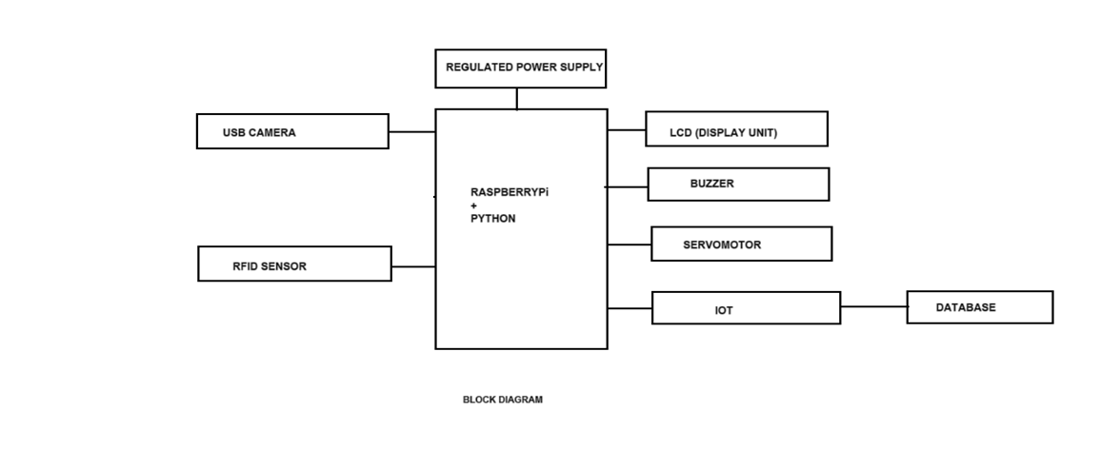
BLOCK DIAGRAM
FIGURE 1 : FUNCTIONAL BLOCK DIAGRAM

Slide 6
COMPONENTS USED
RASPBERRYPi 3 MODULE
USB CAMERA
RFID SENSOR
REGULATED POWER SUPPLY
LCD( DISPLAY UNIT)
BUZZER
SERVOMOTOR

Slide 7
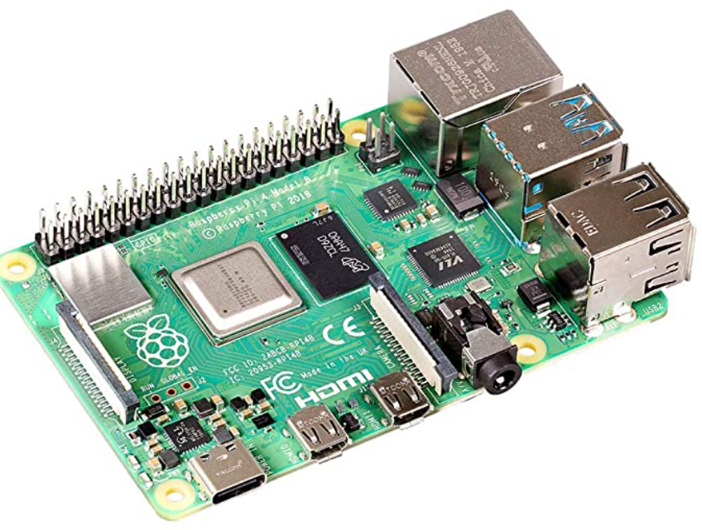
RASPBERRYPi :
The Raspberry Pi 3 is the third generation Raspberry Pi. This powerful credit-card sized single board computer can be used for many applications and supersedes the original Raspberry Pi Model B+ and Raspberry Pi 2 Model B. Whilst maintaining the popular board format the Raspberry Pi 4brings you a more powerful processer, 10x faster than the first generation Raspberry Pi. Additionally it adds wireless LAN & Bluetooth connectivity making it the ideal solution for powerful connected designs.
RaspberryPi Specifications:
Quad Core 1.2GHz Broadcom BCM2837
64bit CPU
1GB RAM
BCM43438 wireless LAN and Bluetooth
Low Energy (BLE) on board
40-pin extended GPIO
4 USB 2 ports
FIGURE 2: RASPBERRYPi PROCESSOR

Slide 8
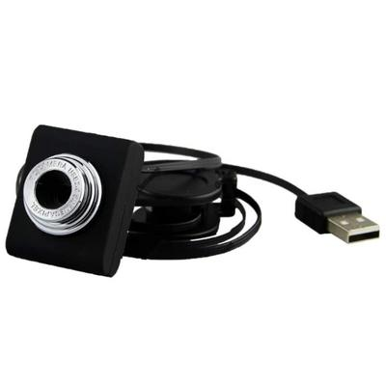
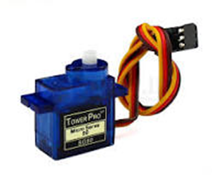
USB Camera:
Plug-and-play connectivity: USB cameras are easy to set up and use.
High-quality video: Many USB cameras offer high-resolution video (e.g., 1080p, 4K).
Wide range of resolutions: USB cameras are available in various resolutions, from low-resolution to high-resolution.
Servo Motor:
Precision motor that rotates to specific angles based on electrical signals. Commonly used in robotics, RC vehicles, and automation systems for precise control of motion.
FIGURE 3: USB camera
FIGURE 4: Servomotor

Slide 9
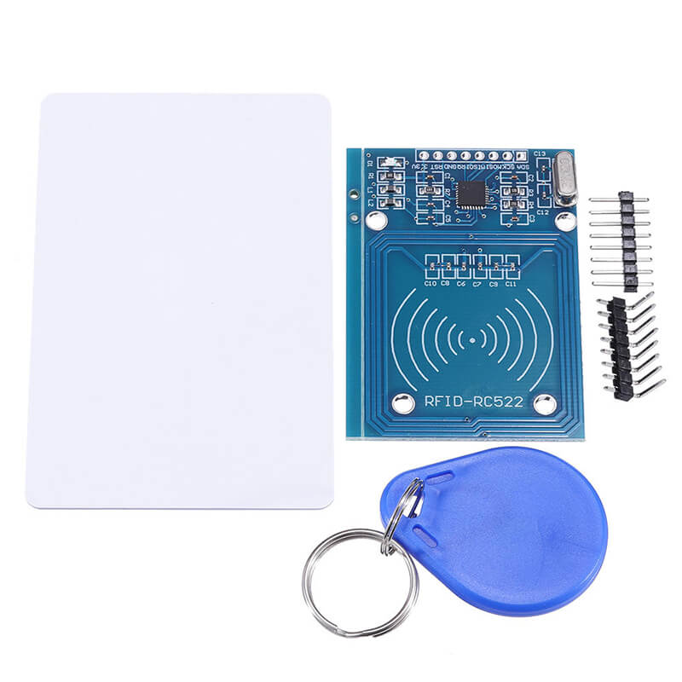
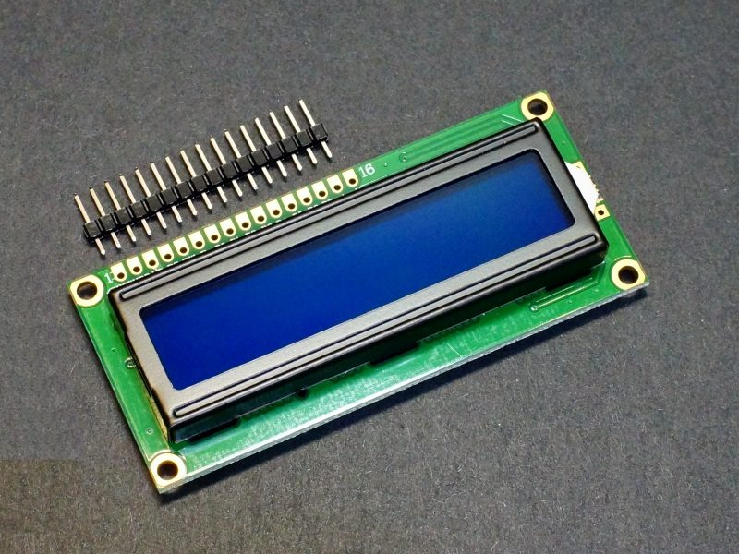
RFID: RFID is a technology that uses radio waves to identify, track, and manage objects, people, or animals. It consists of:
RFID Tag: A small device attached to the object being tracked, containing a microchip and antenna.
RFID Reader: A device that sends and receives radio signals to communicate with RFID tags.
LCD :
Raspberry Pi boards can be connected to LCD displays for various projects, providing a user-friendly interface for interaction and visualization.
FIGURE 5: RFID tag & reader
FIGURE 6: LCD

Slide 10
SOFTWARE USED:-
OpenCV:
Open Source Computer Vision Library is a widely used library for computer vision and image processing.
Image and video processing: OpenCV offers functions for image and video processing, including filtering, thresholding, and feature detection.
Object detection: OpenCV provides algorithms for object detection, such as Haar cascades and deep learning-based models.
Face detection and recognition: OpenCV includes face detection and recognition capabilities.
Tracking: OpenCV offers tracking algorithms for objects and features.
Machine learning: OpenCV integrates with machine learning libraries, enabling the use of computer vision in machine learning applications.
Python for RaspberryPi:
Python is a popular programming language for Raspberry Pi projects due to its ease of use and extensive libraries.

Slide 11
APPLICATIONS:
Smart Parking
Security
Traffic management
Access control
Vehicle Tracking
Toll Collection

Slide 12
ADVANTAGES:
Enhanced Security
24/7 monitoring
Real-time alerts
Accurate Identification
Machine-learning based
Scalability

Slide 13
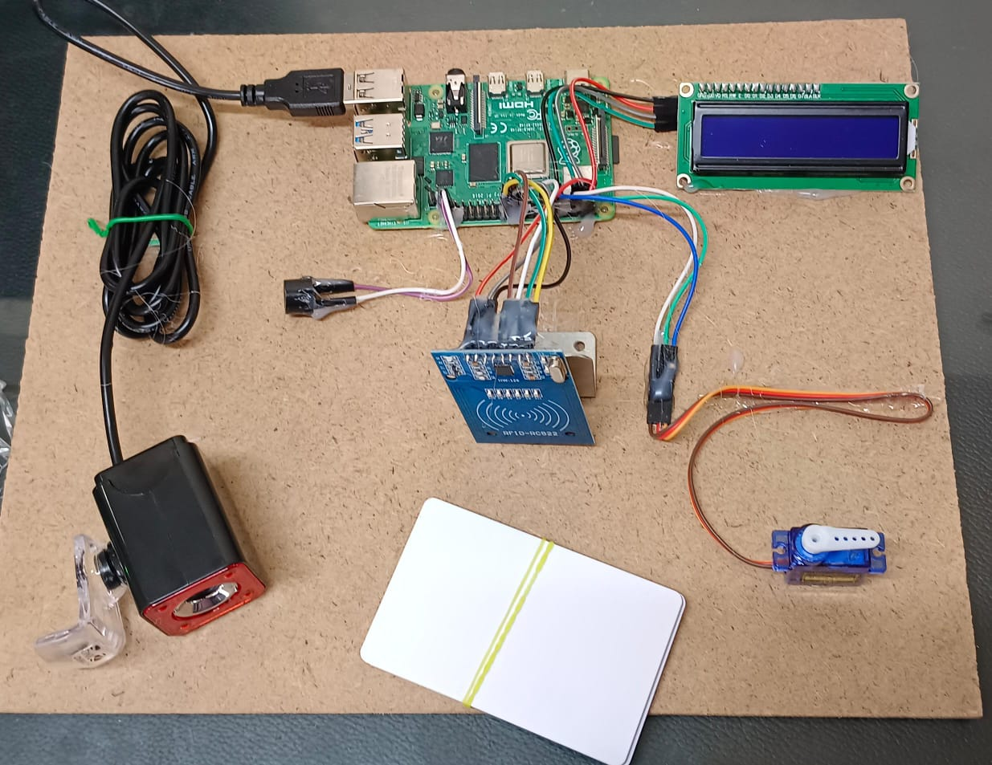
HARDWARE COMPONENTS OF THE PROJECT:
Fig 1 : Hardware Components of the project

Slide 14
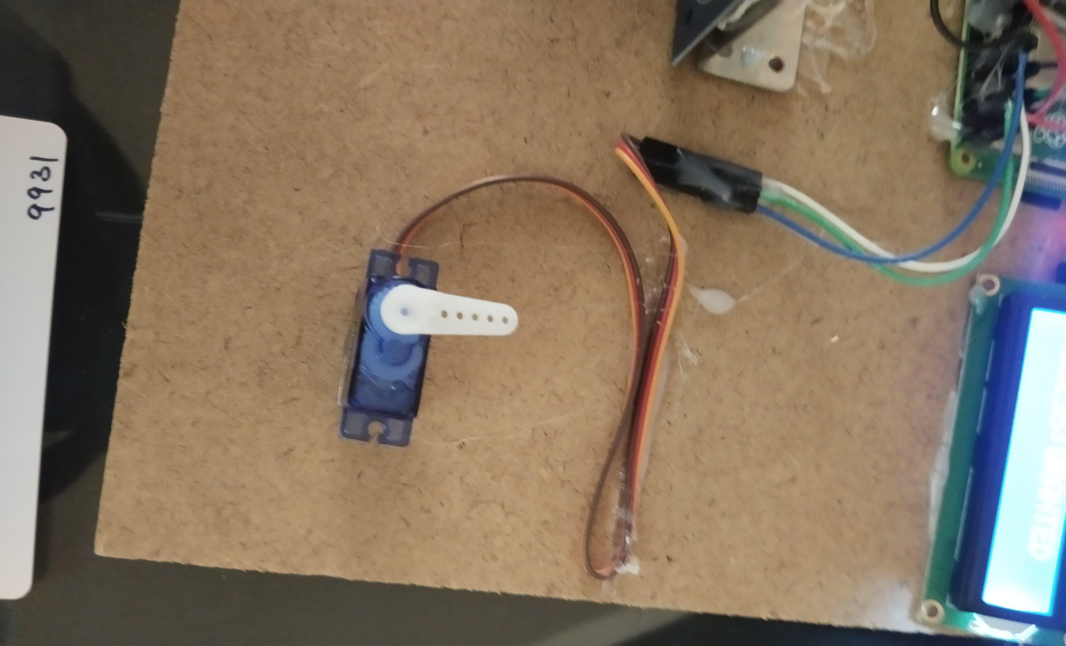
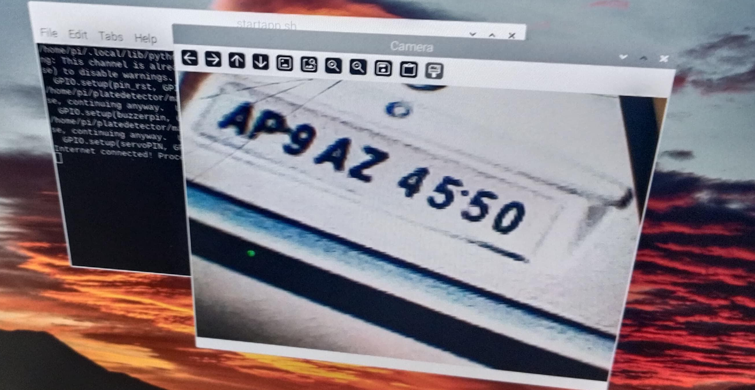
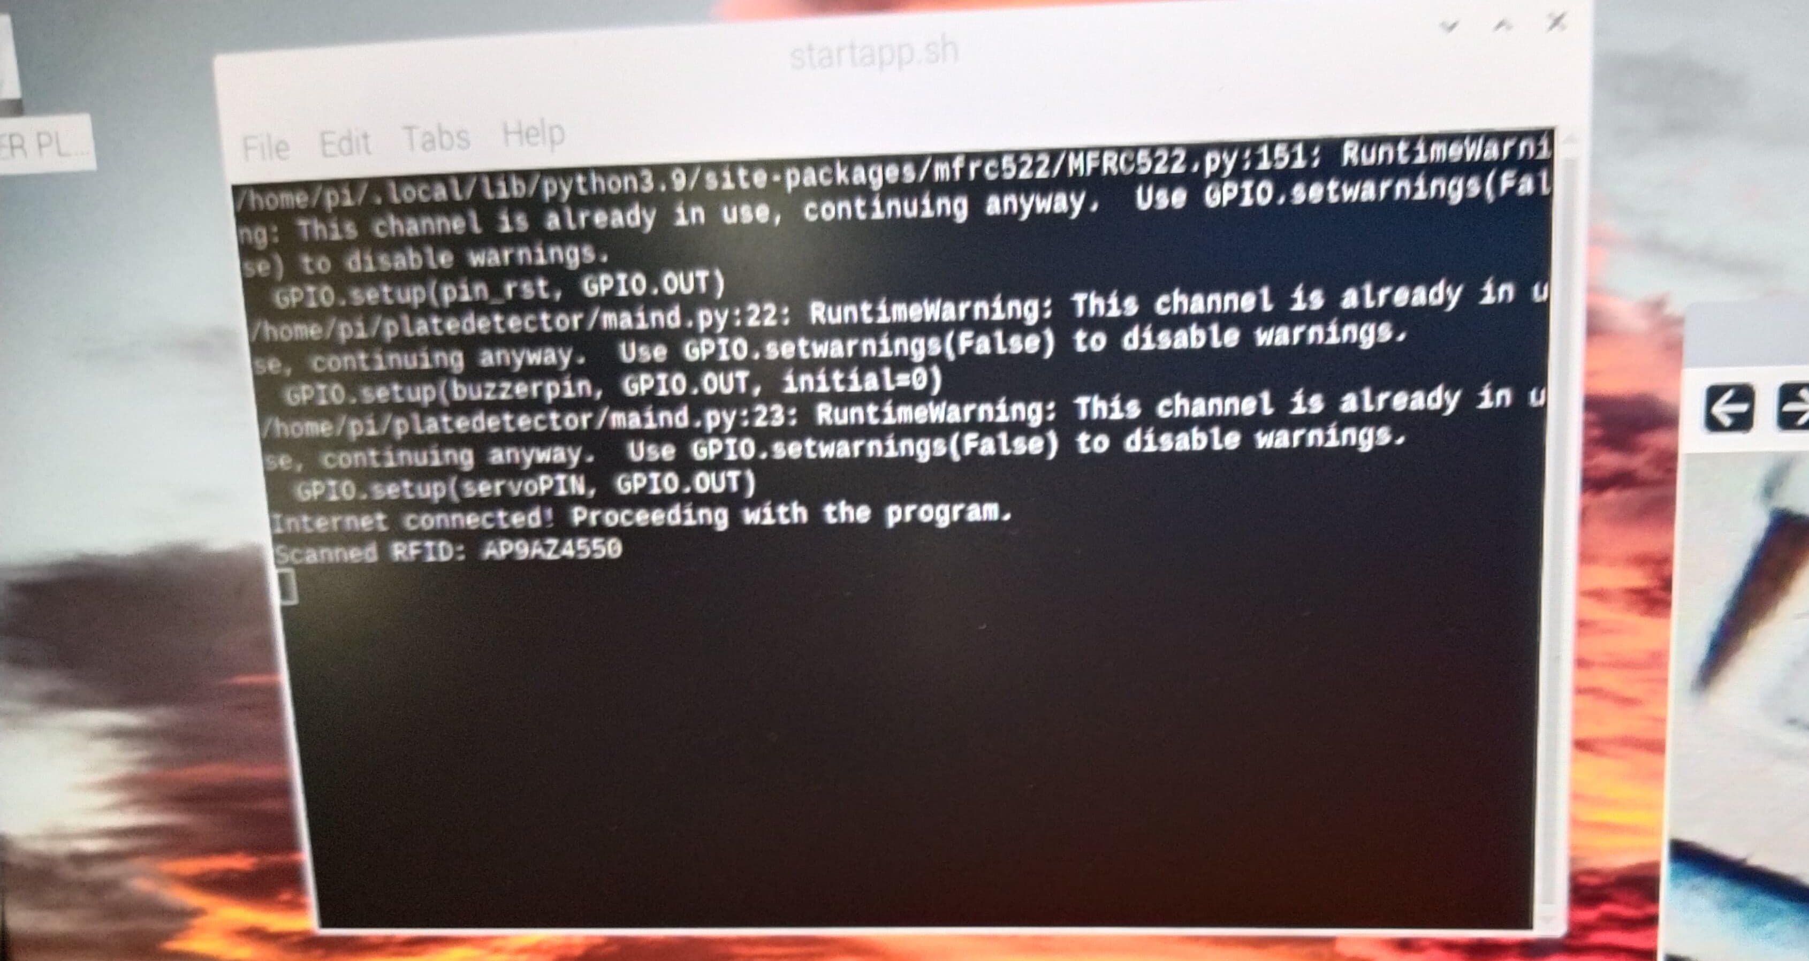
OUTPUT OF THE PROJECT:
Fig 2 : RealVNC viewer capturing the image
Fig 4 : Servo motor giving access to
authorised number plate
Fig 3 : Scanned by RFID in RealVNC viewer

Slide 15
CONCLUSION:
Automated Number Plate Recognition: The project develops an IoT-integrated machine learning system using Raspberry Pi and Python to automate vehicle number plate recognition for access control.
Smart Access Control: The system grants authorized access to restricted areas like parking lots, residential complexes, and secured premises by matching recognized number plates against a database.
Real-time Operation: The system operates in real-time, using a camera module, ultrasonic sensor, and servo motor to capture images, detect vehicles, and control access.
Technological Integration: The project showcases the intersection of IoT, machine learning, and computer vision (OpenCV and OCR) to deliver a cost-effective and efficient solution.
Contribution to Smart Cities: The project contributes to the vision of smart cities by enhancing security, traffic management, resource efficiency, and user convenience, paving the way for future developments in automated security solutions.

Slide 16
FUTURE SCOPE:
Integration with Smart City Infrastructure
Advanced anomaly detection.
Mobile application integration
Enhanced user experience
Integration with other security systems
Artificial intelligence - powered access control
Cyber security Enhancements
Augmented reality integration

Slide 17
REFERENCES:
[1]Zang, D., Chai, Z., Zhang, J., Zhang, D., & Cheng, J. (2015). Vehicle license plate recognition using visual attention model and deep learning. Journal of Electronic Imaging, 24(3), 033001
[2]Sirithinaphong, T., & Chamnongthai, K. (1999). The recognition of car license plate for automatic parking system. In ISSPA'99. Proceedings of the Fifth International Symposium on Signal Processing and its Applications (IEEE Cat. No. 99EX359) (Vol. 1, pp. 455-457). IEEE.
[3]Wang, J., Bacic, B., & Yan, W. Q. (2018). An effective method for plate number recognition. Multimedia Tools and Applications, 77(2), 1679-1692.
[4]Al-Ghaili, A. M., Mashohor, S., Ramli, A. R., & Ismail, A. (2012). Vertical-edge-based car-license-plate detection method. IEEE transactions on vehicular technology, 62(1), 26- 38.
[5]Qin, Z., Shi, S., Xu, J., & Fu, H. (2006). Method of license plate location based on corner feature. In 2006 6th World Congress on Intelligent Control and Automation (Vol. 2, pp. 8645-8649). IEEE.

Slide 18
THANK YOU

